Slide 1
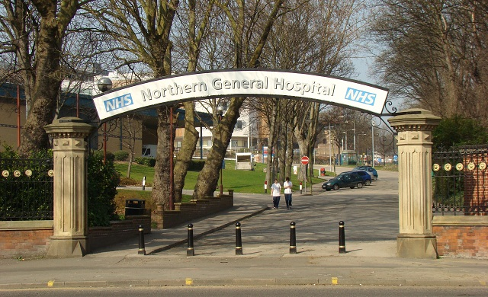
Hepatology ATP Yorkshire - 6 months in Sheffield

Slide 2
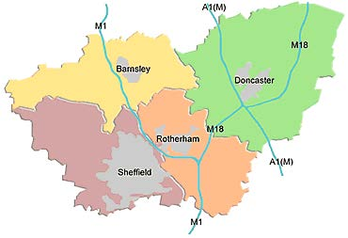
Overview
Yorkshire rotation
- 2 trainees alternating
6 months in Sheffield and 6 months in Leeds
Sheffield Post
3-4 registrars covering hepatology at predominantly Northern General site in Sheffield (3-4 also covering Luminal Gastroenterology)
Specialist non-transplant advice to South Yorkshire Hospitals (including TACE and TIPSS)
Sheffield NHS teaching Trust is 2 hospitals (Northern General and Royal Hallamshire)
Job is predominantly based at the Northern General

Slide 3
Typical ward based timetable (1 in 3-4 weeks)
Ward week
 | AM | PM
Monday | 08.00 Consultant meeting 08.30 Histopathology meeting 09.00 SpR led WR | Support ward team / SPA time
Tuesday | 08.00 CNS meeting 08.30 TACE MDT 09.00 SpR led WR 11.30 Benign radiology MDT 12.30 Cons / SPR Liver teaching | 13.30 Varices list
Wednesday | 09.00 SpR-led WR | 13.30 Hepatology New Ward Discharge clinic
Thursday | 08.30 AIH MDT 09.00 SpR-led WR | Support ward team / SPA time
Friday | 09.00 SpR led WR | Support ward team / SPA time
Robert Hadfield 3 and 4 (each 26 bedded)
Patients split between luminal (2 teams) and liver (1 team)
Liver usually has 30-45 patients (which is often double the number of luminal patients)
Outliers (between 0 and 10)
Variable junior staffing (2-3 juniors covering liver and liver outliers)
SPRs may need to help with jobs on wards i.e. paracentesis, consenting patients
Consultants do 2 weeks on ward at a time
Complex mix of inpatients and good opportunity to discuss with consultants (and do WBPAs)

Slide 4
Typical non-ward based timetable (2-3 weeks in 4)
Ward week
 | AM | PM
Monday | 08.00 Consultant meeting 08.30 Histopathology meeting 09.00 SPA time | Mixed OP clinic (predominantly autoimmune)
Tuesday | 08.00 CNS meeting 08.30 TACE MDT 09.00 – 10.30 Upper GI MDT 11.30 Benign radiology MDT 12.30 TIPSS MDT (1 in 6) 12.30 Cons / SPR Liver teaching | 13.30 Varices list
Wednesday | On call Gastro (09.00 – 17.00) Answering online referrals and bleep
Thursday | 08.30 AIH MDT 09.00 Mixed OP clinic (predominantly HPB) | 13.30 Optional Endoscopy list
Friday | SPA time | SPA time
Flexibility in SPA time depending on clinical commitments to attend other educational activities
Endoscopy lists
Specialist clinics
Audit / Management
In house training (UGIB course)
Regional and national training

Slide 5
Pro’s of Sheffield
Good opportunity to attend OP clinics (including specialist clinics i.e. Wilson’s, transplant clinics) | Supportive consultant body with opportunity to discuss difficult cases and opinion is valued. Educational activities common so opportunity to teach and be taught | Opportunity to continue endoscopy training (once weekly varices list and other lists through discussion) | No on call component and no GIM (9-5 Monday to Friday) | On non-ward week, 2 clinics, 1-2 endoscopy lists and 1 “gastro on call” day (with 4 SPA days) | Can attend specialist MDTs including TIPSS, TACE and develop leadership & management skills*
*IMTs predominant on SPR rota so seen as “senior” SPR for advice

Slide 6
Drawbacks
No on call supplement
No direct transplant experience (but will get in Leeds and opportunity to do outreach clinics if required)
Ward weeks can be hard (30-45 inpatients with limited junior cover)
Changes to clinics during COVID mean you rarely do a clinic physically alongside a consultant limiting direct learning opportunities

Slide 7
Key Contacts
Current Hepatology ATP Trainee (September 2021-March 2022)
James Morgan
James.morgan18@nhs.net
nt
Dr Barbara Hoeroldt (barbara.hoeroldt1@nhs.net)
Clinical Lead for Hepatology and Education
Supervisor for Hepatology ATP trainee
Other consultants
Dr Amer Al-Joudeh
Dr Yasser El-Sherif
Professor Dermot Gleeson
Dr Laura Harrison
Dr Claire Salmon
For rota based queries, katie.bowes2@nhs.net

